Slide 1
Areas of Assessment
Livelihood zones
Framework

Slide 2
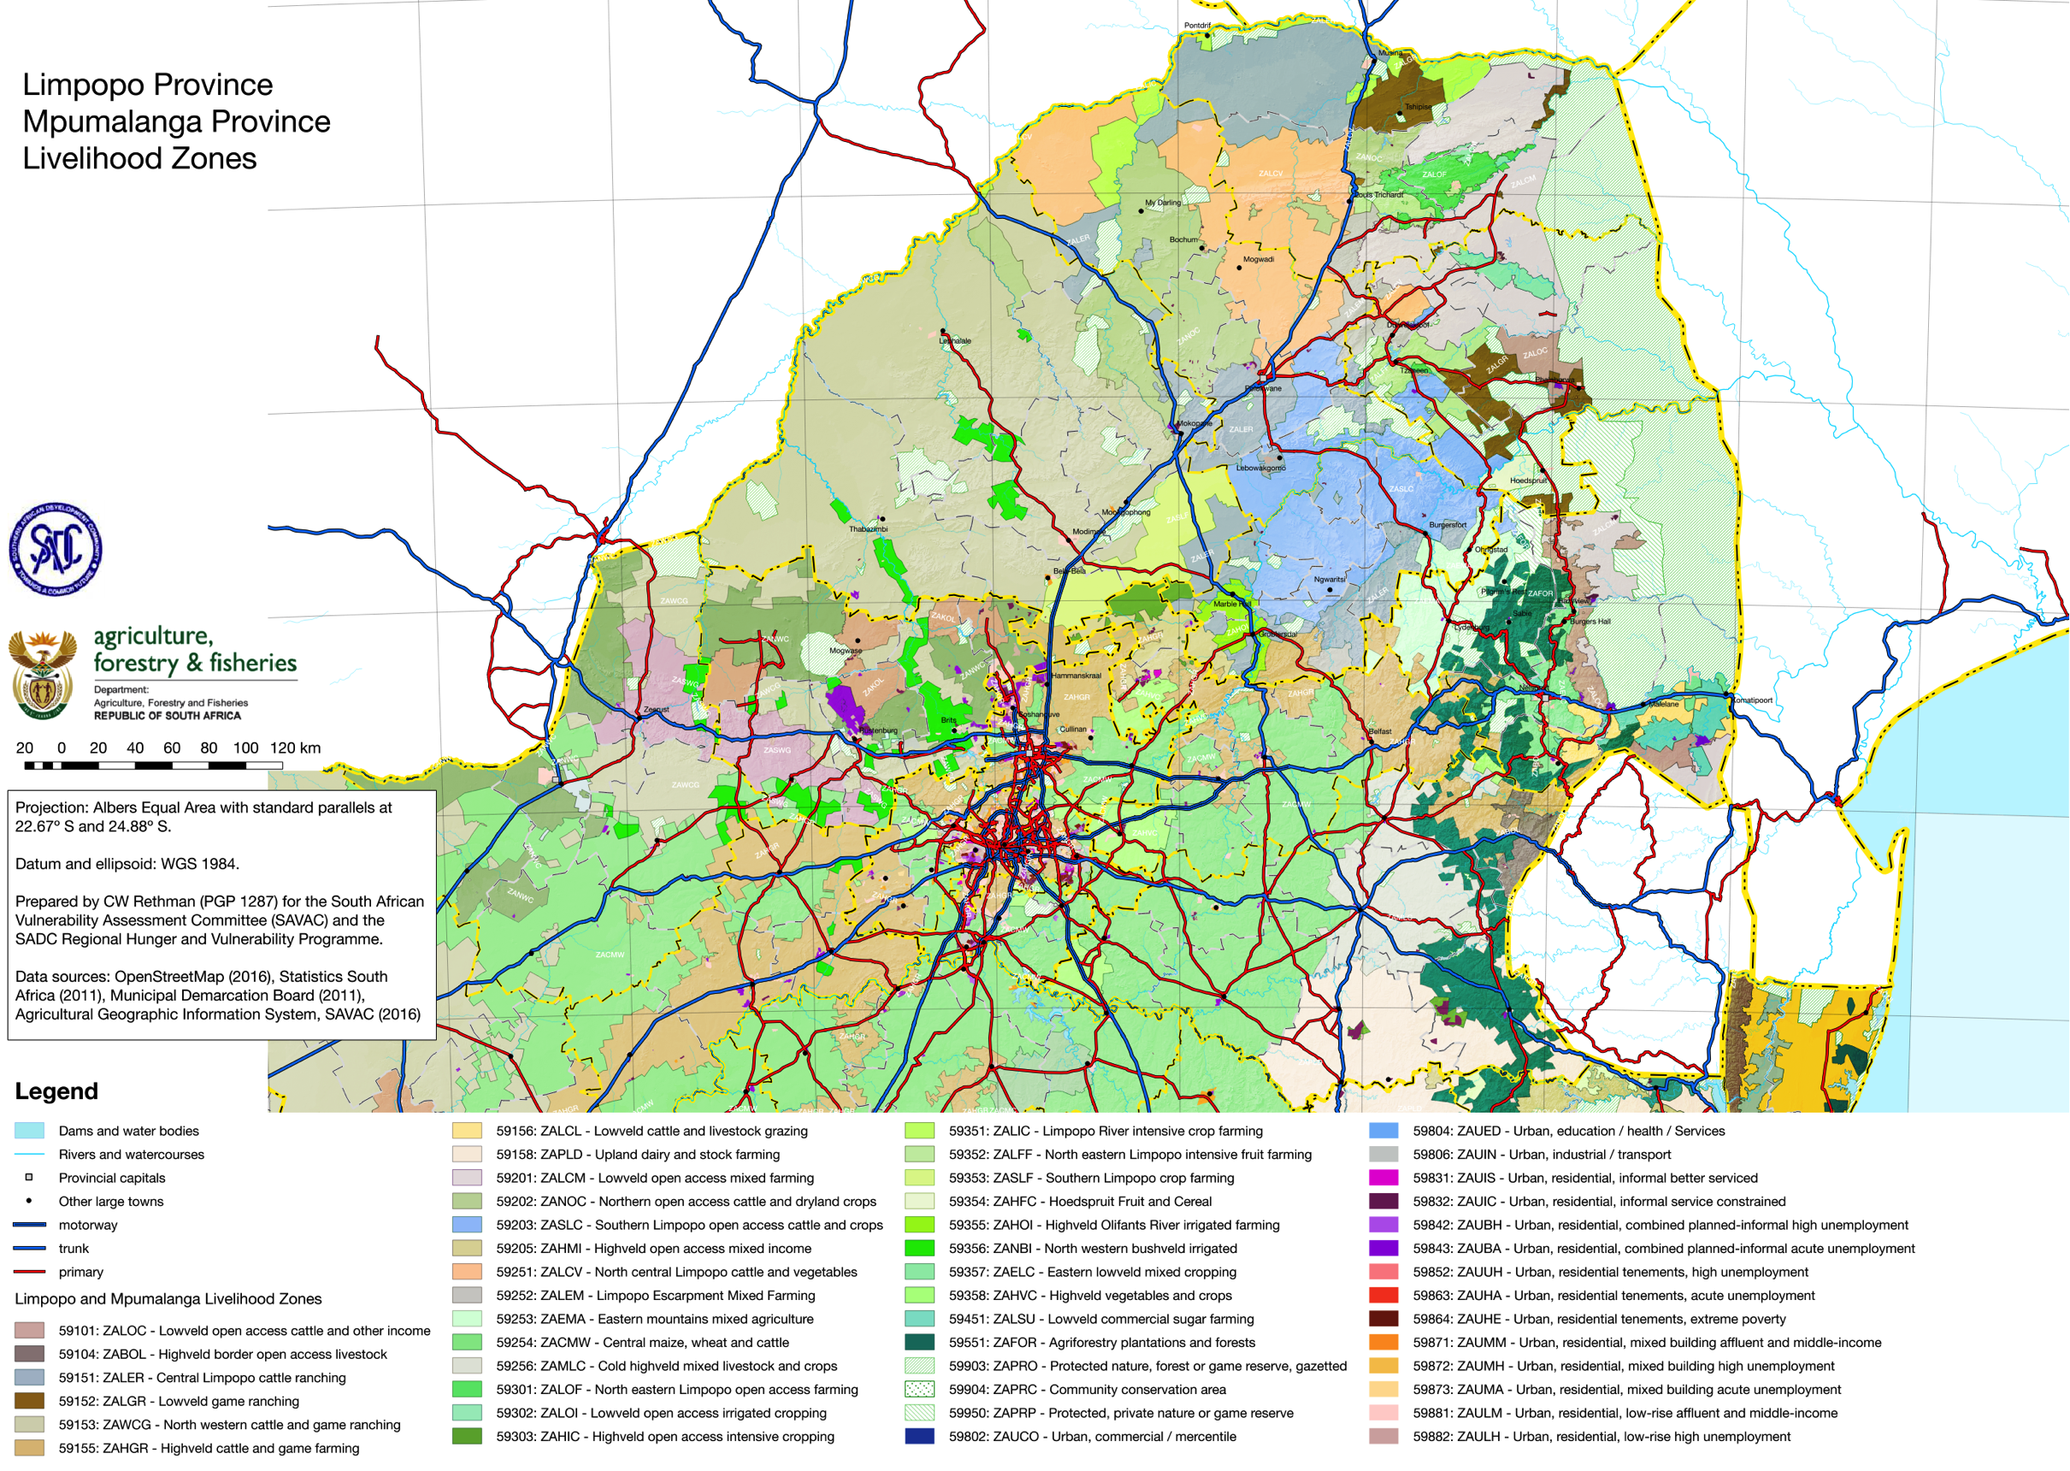

Slide 3
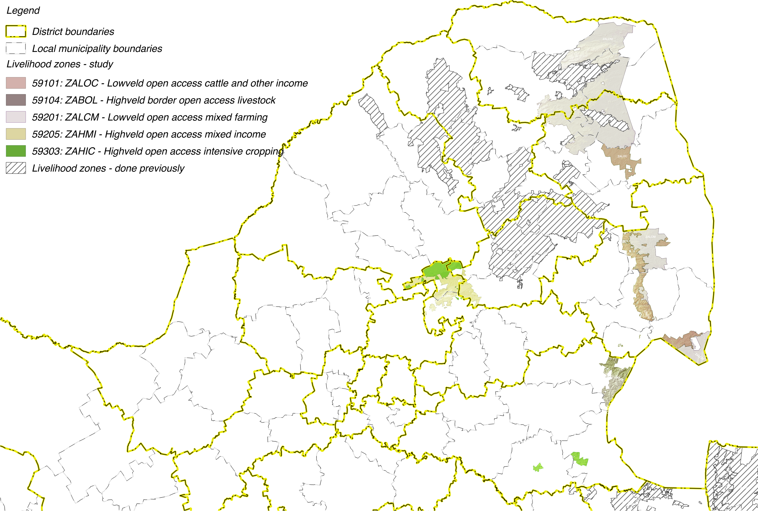

Slide 4
Livelihoods Findings:
Wealth Descriptions and Wealth Breakdowns

Slide 5
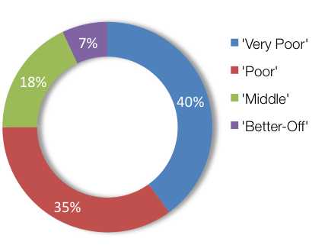
Wealth Breakdowns & Descriptions: ZALCM – Lowveld Open Access Mixed Farming (59201)
WEALTH GROUP | LIVESTOCK (cattle) | FARM SIZE (ha) | MAIN INCOME
Very Poor | 0 – 7 [4] | 1.0 | Grants
Poor | 3 – 10 [5] | 1.5 | Grants
Middle | 10 – 50 [20] | 2.0 | Employ
Better Off | 15 – 200 [50] | 2.0 | Employ/agric

Slide 6
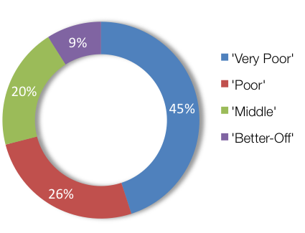
Wealth Breakdowns & Descriptions: ZALOC – Lowveld Open Access Cattle and Other Income (59101)
WEALTH GROUP | LIVESTOCK (cattle) | FARM SIZE (ha) | MAIN INCOME
Very Poor | 0 | 0.2 | Grants
Poor | 0 – 4 [2] | 0.3 | Grants
Middle | 0 – 15 [10] | 0.3 | Employ
Better Off | 5 – 60 [30] | 4.0 | Employ

Slide 7
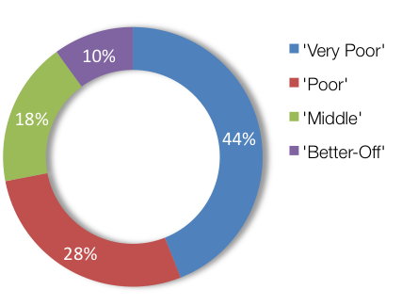
Wealth Breakdowns & Descriptions: ZABOL – Highveld border open access livestock (59104)
WEALTH GROUP | LIVESTOCK (cattle) | FARM SIZE (ha) | MAIN INCOME
Very Poor | 0 | 0.25 | Grants
Poor | 0 – 4 [3] | 0.5 | Grants
Middle | 5 – 13 [10] | 1.0 | Employ
Better Off | 10 – 25 [20] | 2.0 | Employ

Slide 8
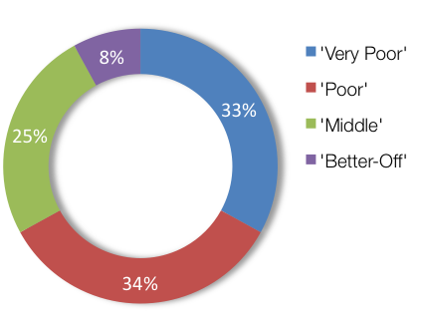
Wealth Breakdowns & Descriptions: ZAHIC – Highveld Open Access Intensive Cropping (59303)
WEALTH GROUP | LIVESTOCK (cattle) | FARM SIZE (ha) | MAIN INCOME
Very Poor | 0 | 0.75 | Grants
Poor | 0 – 4 [2] | 1.0 | Grants
Middle | 0 – 15 [10] | 1.2 | Employ
Better Off | 5 – 60 [30] | 2.0 | Employ/agric

Slide 9
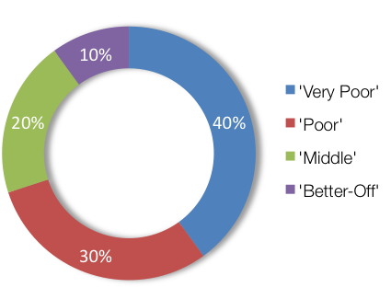
Wealth Breakdowns & Descriptions: ZAHMI – Highveld Open Access Mixed Income (59205)
WEALTH GROUP | LIVESTOCK (cattle) | FARM SIZE (ha) | MAIN INCOME
Very Poor | 0 | 0.5 | Grants
Poor | 0 – 7 [3] | 0.5 | Grants
Middle | 6 – 10 [8] | 0.5 | Employ
Better Off | 10 – 20 [15] | 0.5 | Employ

Slide 10
Livelihoods Findings:
Sources of Food and Income

Slide 11
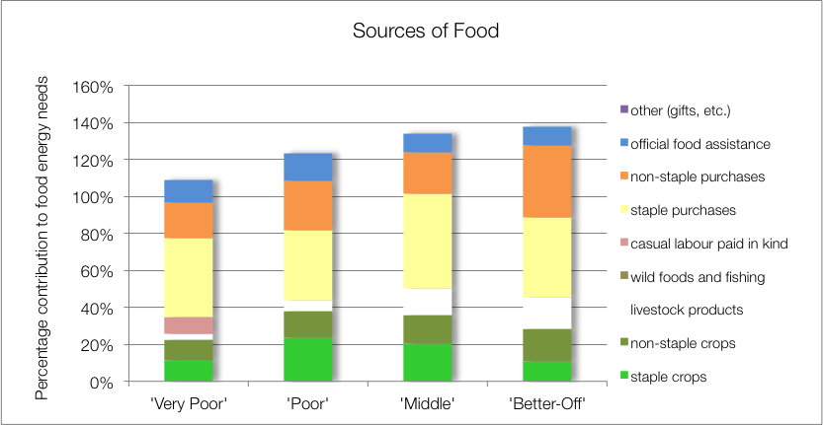
Source of Food: ZALCM – Lowveld Open Access Mixed Farming (59201)

Slide 12
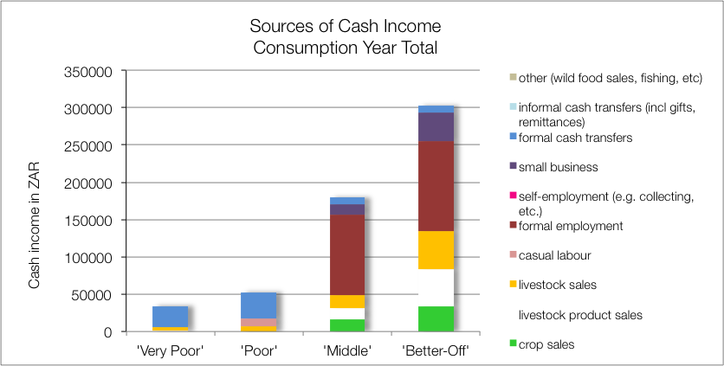
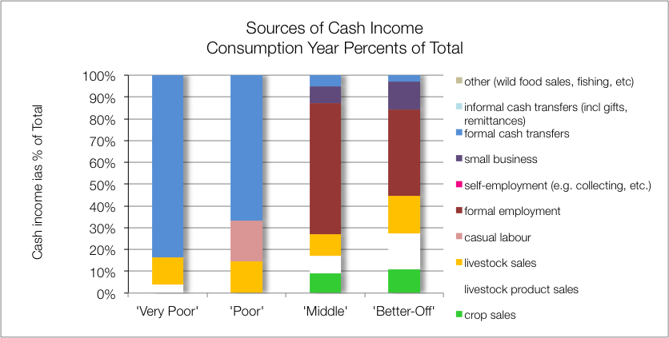
Source of Cash: ZALCM – Lowveld Open Access Mixed Farming (59201)

Slide 13
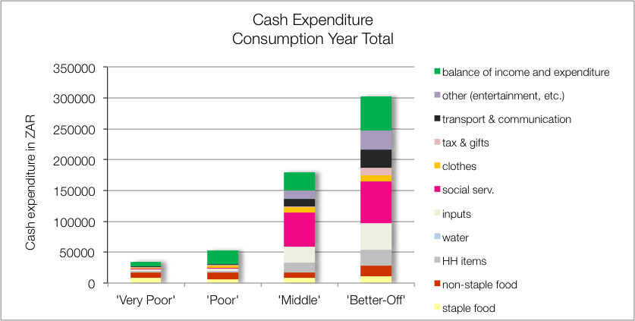
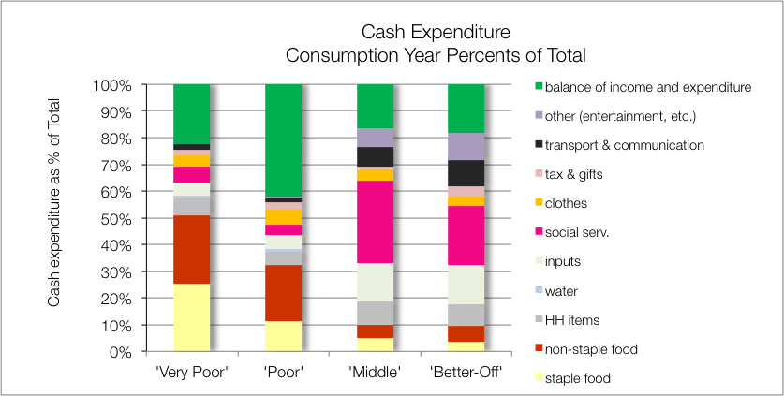
Source of Cash: ZALCM – Lowveld Open Access Mixed Farming (59201)

Slide 14
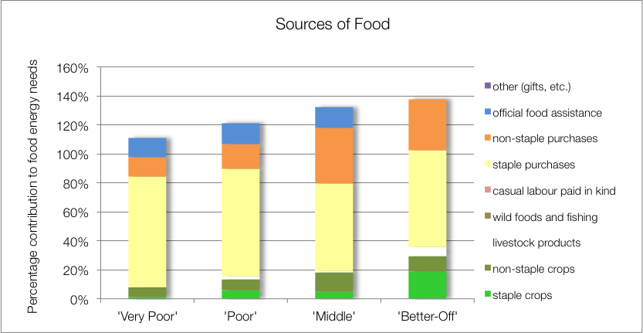
Sources of Food: ZAHIC – Highveld Open Access Intensive Cropping (59303)
Key finding:
Low usage of livestock products (for given herd size)

Slide 15
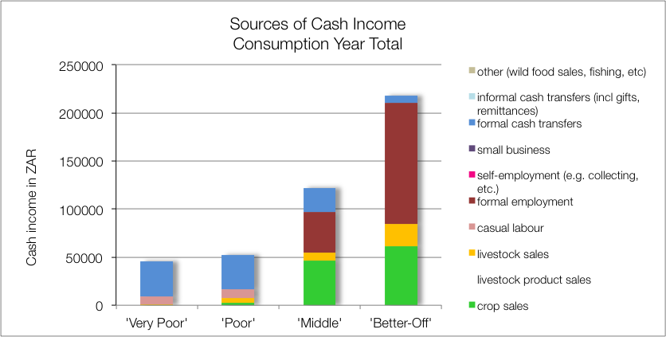
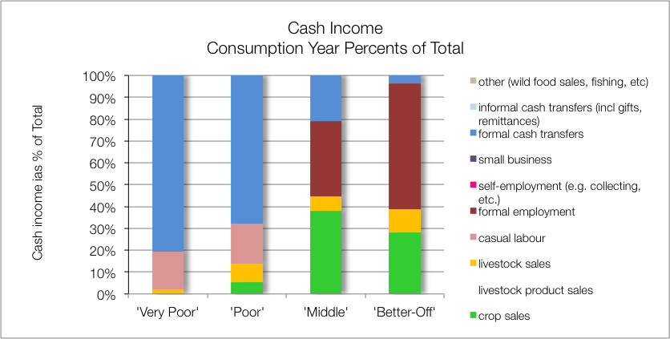
Sources of Cash: ZAHIC – Highveld Open Access Intensive Cropping (59303)

Slide 16
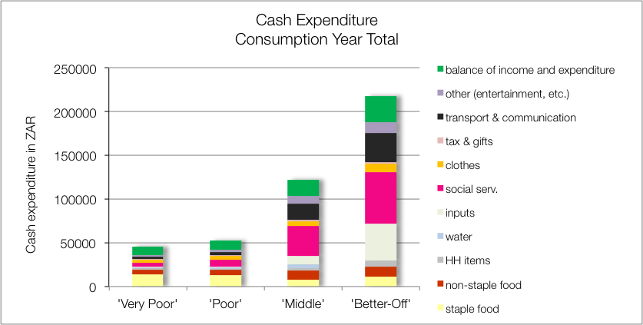
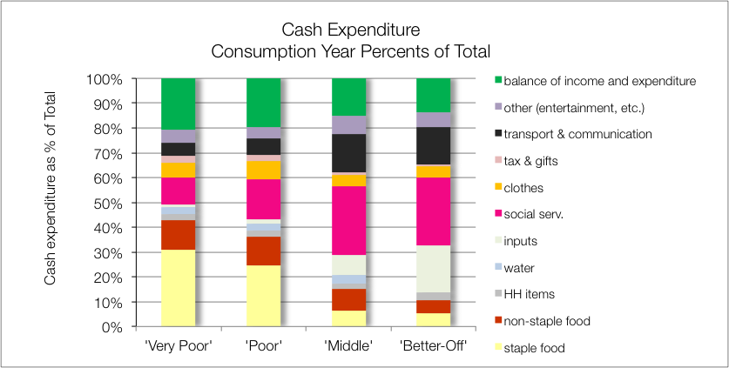
Sources of Cash: ZAHIC – Highveld Open Access Intensive Cropping (59303)

Slide 17
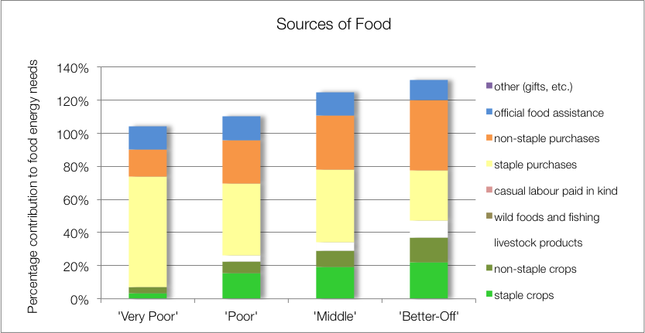
Sources of Food: ZABOL – Highveld border open access livestock (59104)
Key finding:
Low yields and productivity

Slide 18
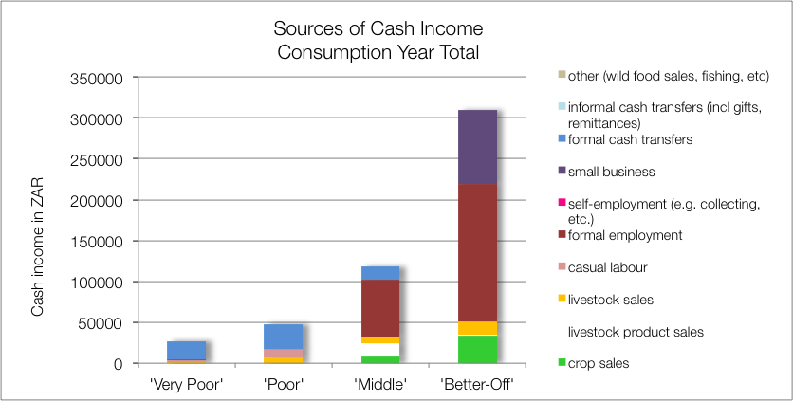
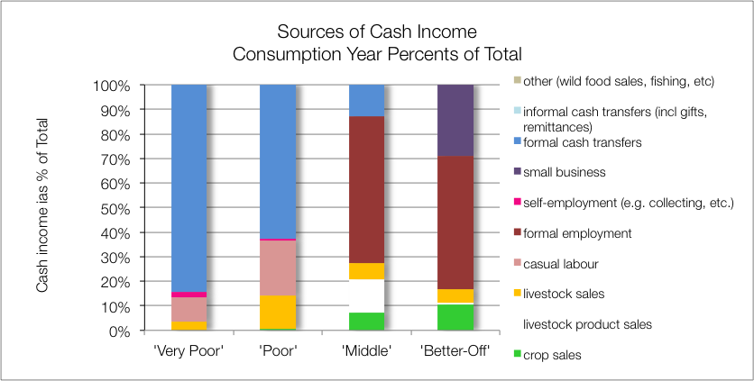
Sources of Cash: ZABOL – Highveld border open access livestock (59104)

Slide 19
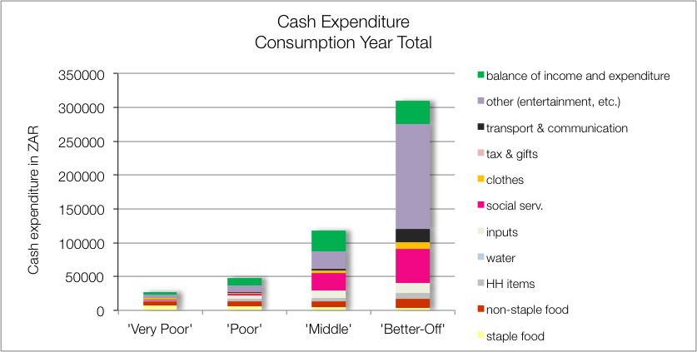
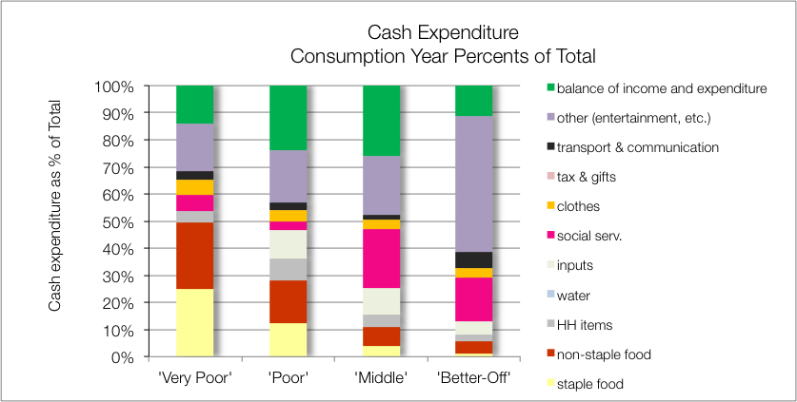
Sources of Cash: ZABOL – Highveld border open access livestock (59104)

Slide 20
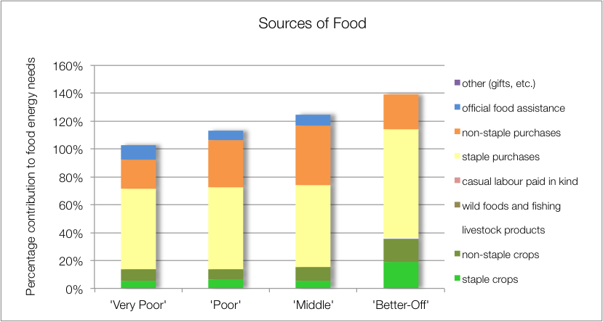
Sources of Food: ZALOC – Lowveld Open Access Cattle and Other Income (59101)

Slide 21
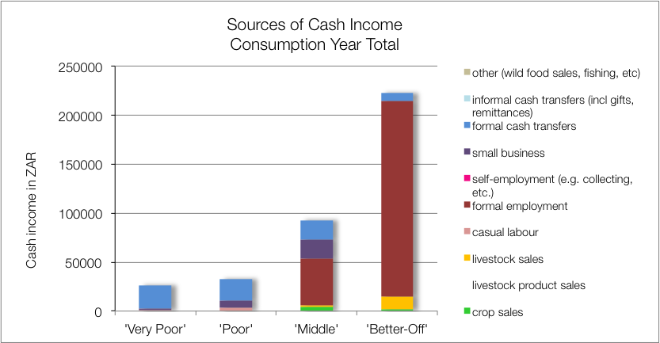
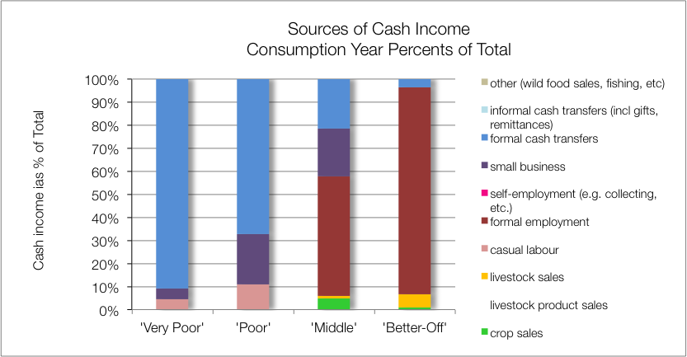
Sources of Cash: ZALOC – Lowveld Open Access Cattle and Other Income (59101)

Slide 22
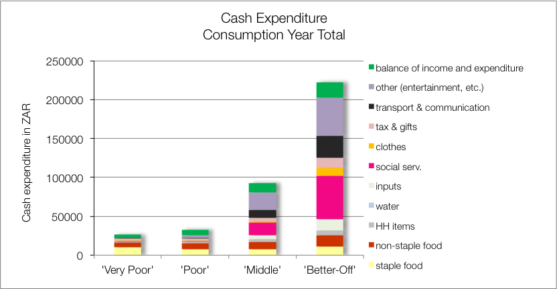
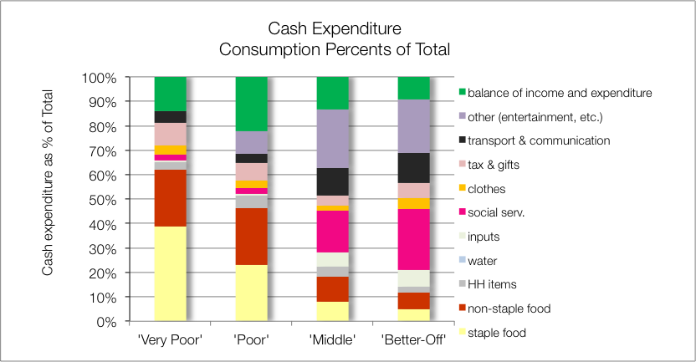
Sources of Cash: ZALOC – Lowveld Open Access Cattle and Other Income (59101)

Slide 23
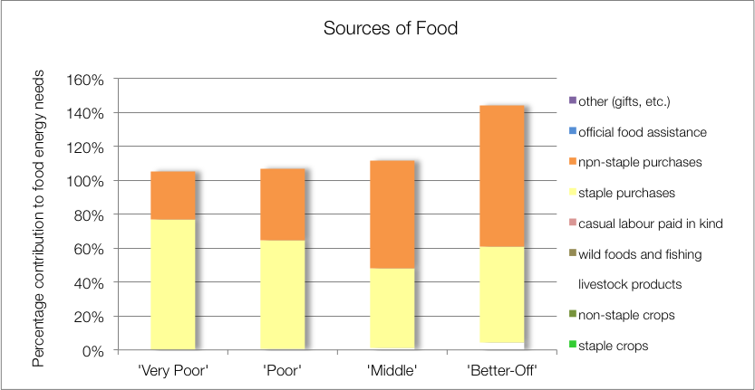
Sources of Food: ZAHMI – Highveld Open Access Mixed Income (59205)

Slide 24
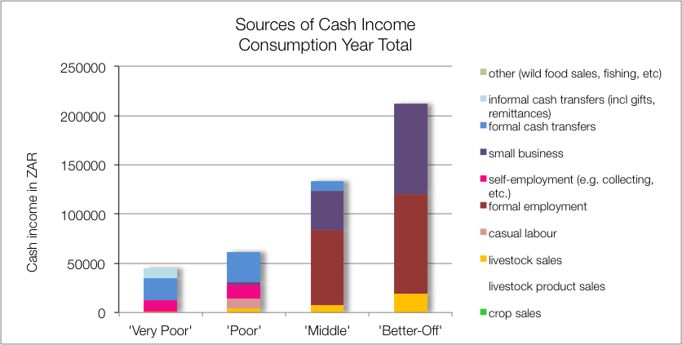
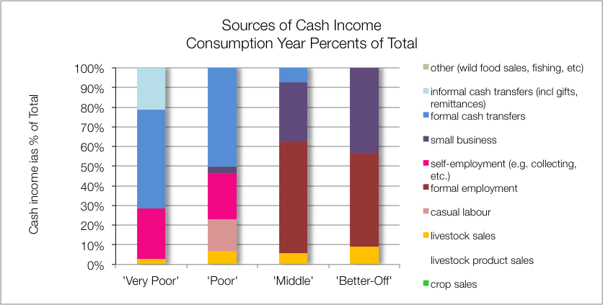
Sources of Cash: ZAHMI – Highveld Open Access Mixed Income (59205)

Slide 25
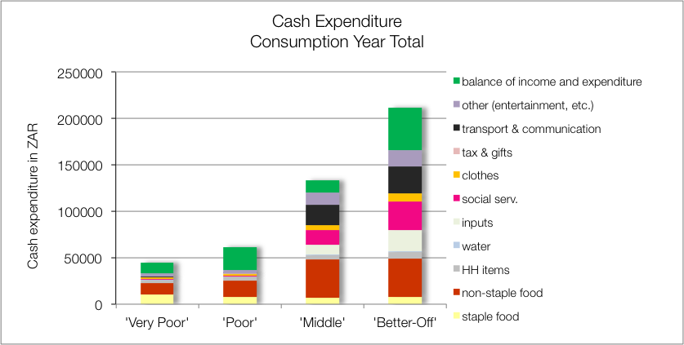
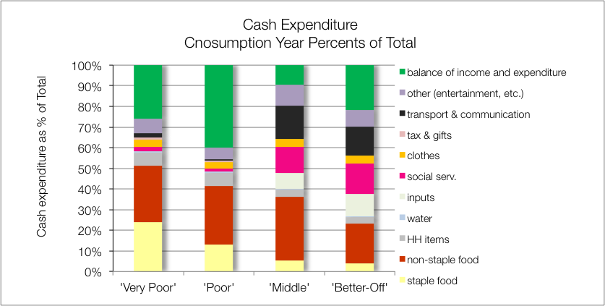
Sources of Cash: ZAHMI – Highveld Open Access Mixed Income (59205)

Slide 26
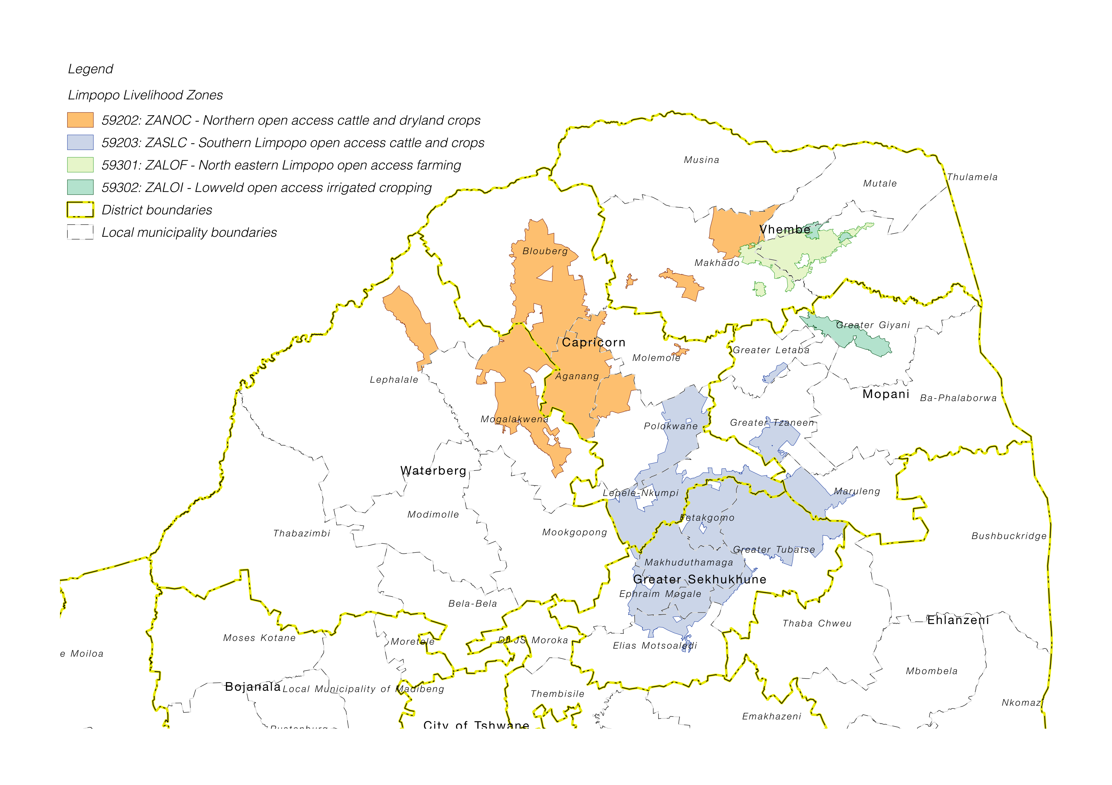
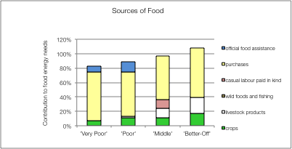
Example of a Forecast: ZASLC – Southern Limpopo Open Access Livestock and Crops
Food Prices Rise by 40%
Crop production falls by 60%
Affects food directly:

Slide 27
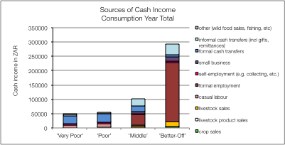
Example of a Forecast: ZASLC – Southern Limpopo Open Access Livestock and Crops
Households will try to manage
They will switch expenditure
But they can only switch their expenditure that is above the FPL
Lower Bound PL
Food PL

Slide 28
Example of a Forecast: ZASLC – Southern Limpopo Open Access Livestock and Crops
Households will try to manage
The FPL will rise by 40%
The LBPL limit will rise as well
Lower Bound PL
Food PL

Slide 29
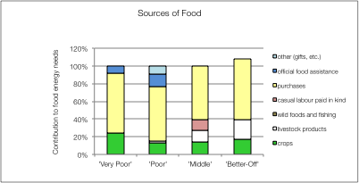
Example of a Forecast: ZASLC – Southern Limpopo Open Access Livestock and Crops
Hence:
By switching, Hhs can meet their basic food needs
BUT, they could be impoverished (below the LBPL)

